Slide 1
Lecture 16: Detection + Segmentation
Lecture 16 - 1

Slide 2
Reminder: A4
A4 due Wednesday, November 13, 11:59pm
A4 covers:
PyTorch autograd
Residual networks
Recurrent neural networks
Attention
Feature visualization
Style transfer
Adversarial examples
Lecture 16 - 1

Slide 3
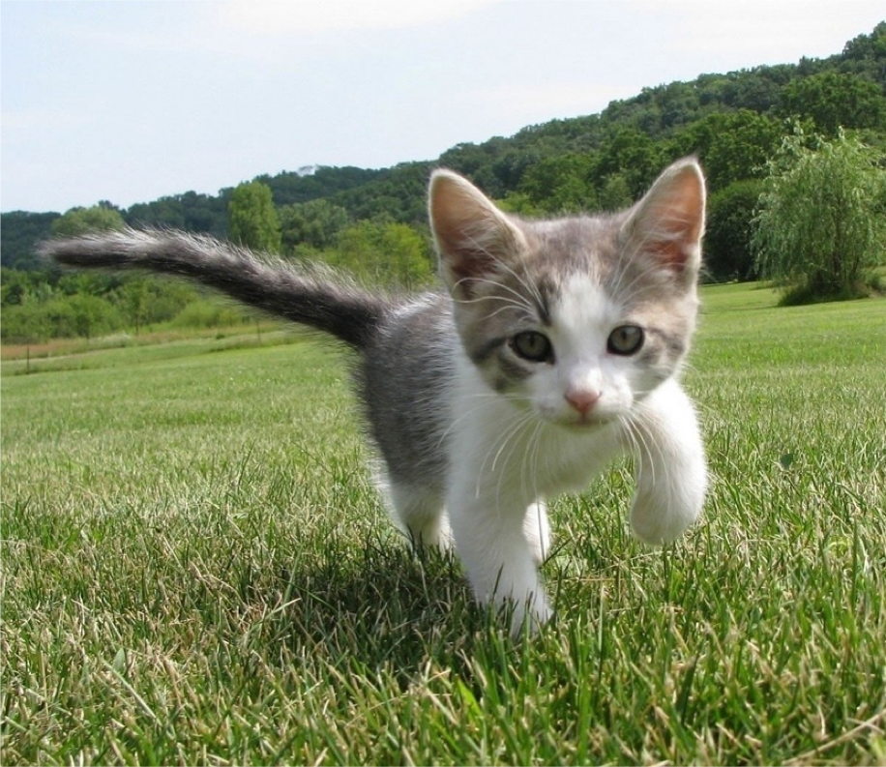
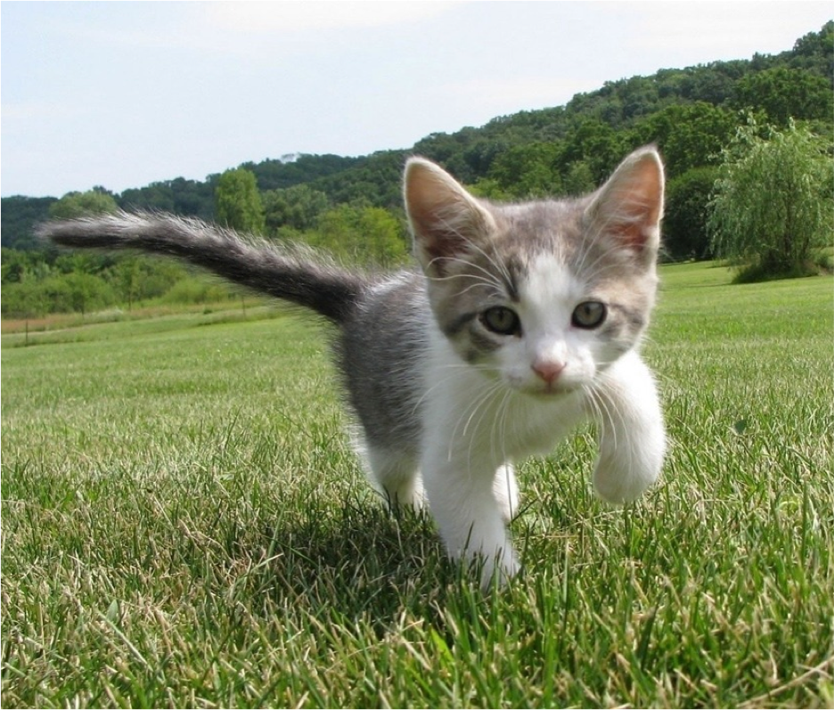
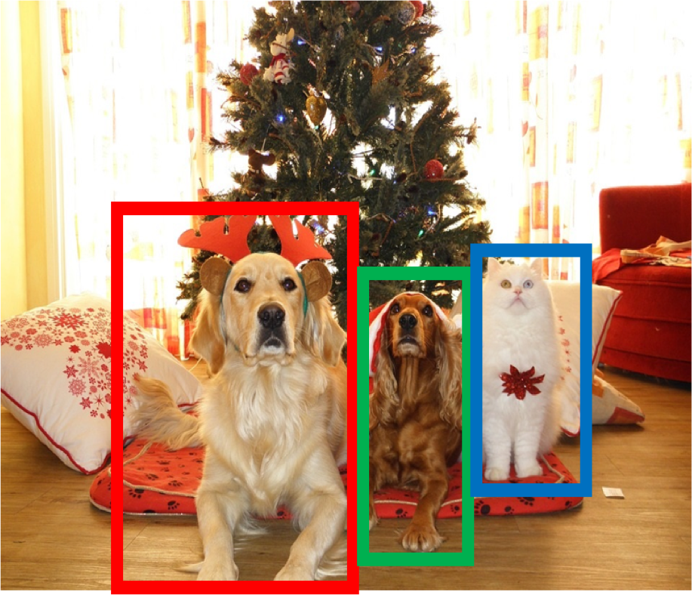
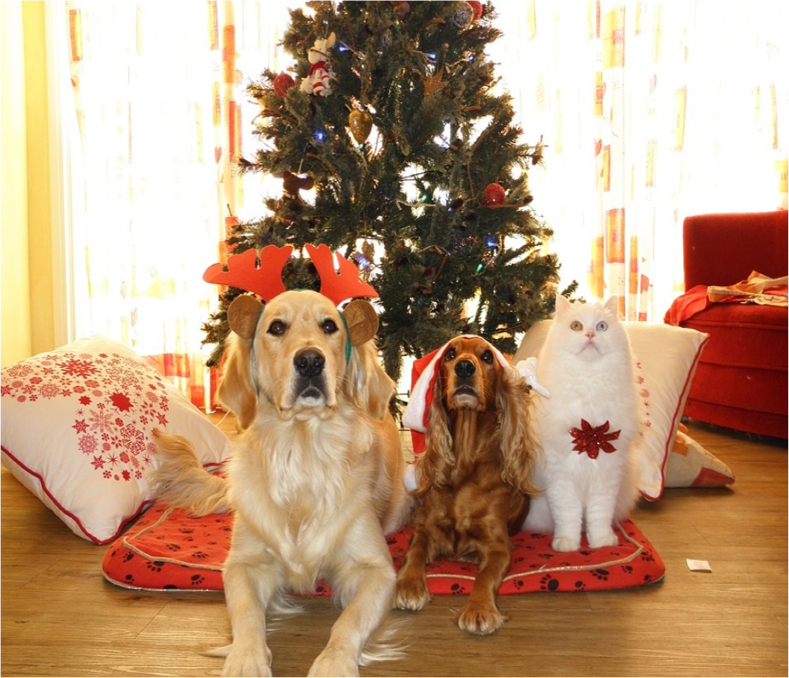
Last Time: Computer Vision Tasks
Semantic Segmentation
Object Detection
Instance Segmentation
Classification
CAT
GRASS, CAT, TREE, SKY
DOG, DOG, CAT
DOG, DOG, CAT
No spatial extent
No objects, just pixels
Multiple Objects
This image is CC0 public domain
Lecture 16 - 1

Slide 4
Last Time: Object Detection
Semantic Segmentation
Object Detection
Instance Segmentation
Classification
CAT
GRASS, CAT, TREE, SKY
DOG, DOG, CAT
DOG, DOG, CAT
No spatial extent
No objects, just pixels
Multiple Objects
Lecture 16 - 1

Slide 5
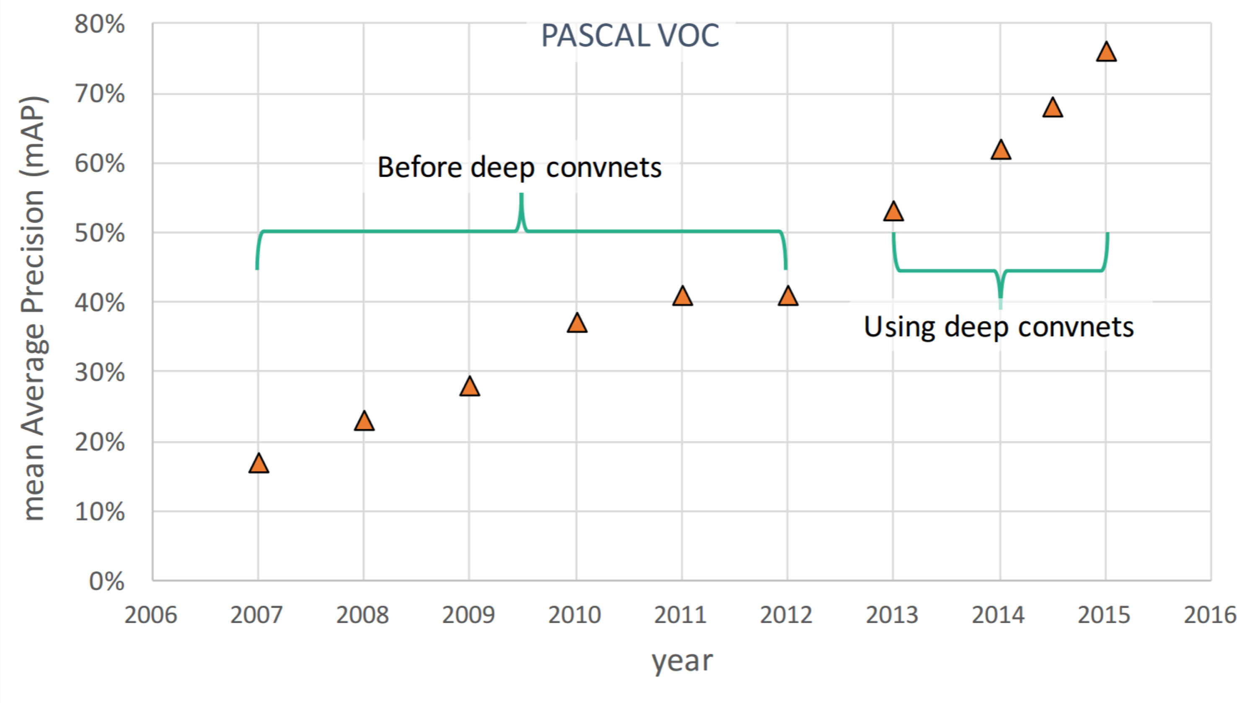
Object Detection: Impact of Deep Learning
Figure copyright Ross Girshick, 2015. Reproduced with permission.
Lecture 16 - 1

Slide 6








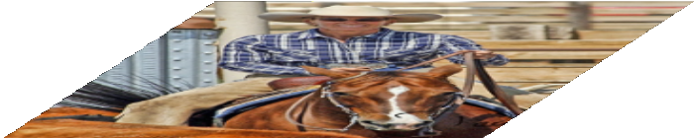
Last Time: Object Detection Methods
“Slow” R-CNN: Run CNN
independently for each region
Fast R-CNN: Apply differentiable cropping to shared image features
Bbox
Class
Bbox
Class
Category and box transform per region
Bbox
Bbox
Bbox
Bbox
Class
Forward each region through ConvNet
Warped image regions (224x224)
Class
Class
Class
Conv Net
Conv Net
Regions of Interest (RoIs) from a proposal method
Per-Region Network
Crop + Resize features Image features
Run whole image through ConvNet
CNN
CNN
CNN
Conv Net
“Backbone” network: AlexNet, VGG, ResNet, etc
Regions of Interest (RoI) from a proposal method (~2k)
Input image
ConvNet
Input image
Lecture 16 - 1

Slide 7
Recap: Slow R-CNN Training
“Slow” R-CNN: Run CNN
independently for each region
Fast R-CNN: Apply differentiable cropping to shared image features
Bbox
Class
Bbox
Class
Bbox Class
Bbox Class
Bbox Category and box
Bbox
Class
Forward each region through ConvNet
Warped image regions (224x224)
Class
transform per region
Conv Net
Conv Net
Regions of Interest (RoIs) from a proposal method
Per-Region Network
Crop + Resize features Image features
Run whole image through ConvNet
CNN
CNN
CNN
Conv Net
“Backbone” network: AlexNet, VGG, ResNet, etc
Regions of Interest (RoI) from a proposal method (~2k)
Input image
ConvNet
Input image
Lecture 16 - 1

Slide 8
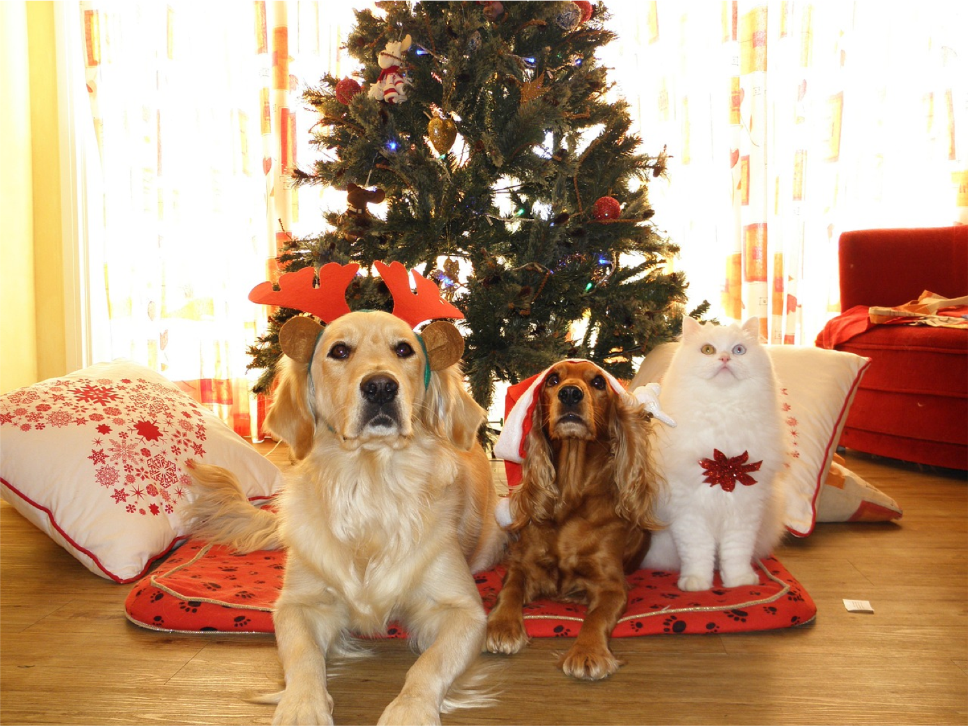
”Slow” R-CNN Training
Input Image
Ground-Truth boxes
This image is CC0 public domain
Lecture 16 - 9

Slide 9
”Slow” R-CNN Training
Input Image
Ground-Truth boxes
Region Proposals
This image is CC0 public domain
Lecture 16 - 9

Slide 10
”Slow” R-CNN Training
Input Image
Categorize each region proposal as positive, negative, or neutral based on overlap with ground-truth boxes
GT Boxes
Neutral
Justin Johnson
Positive
Negative
This image is CC0 public domain

Slide 11
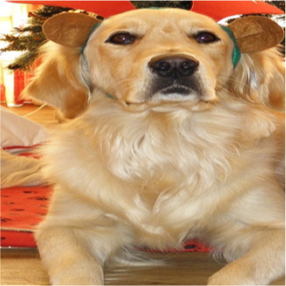
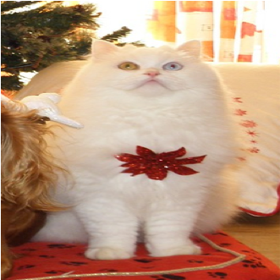
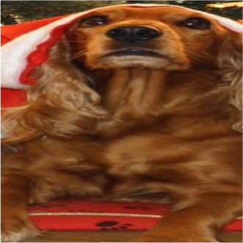
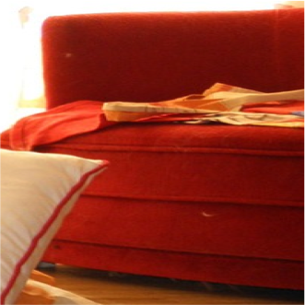
”Slow” R-CNN Training
Input Image
Crop pixels from each positive and negative proposal, resize to 224 x 224
GT Boxes
Neutral
Justin Johnson
Positive
Negative
This image is CC0 public domain

Slide 12
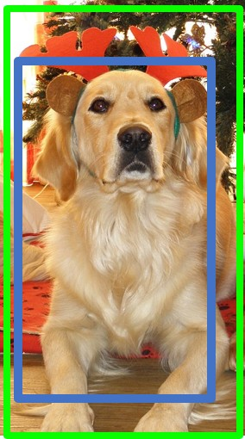
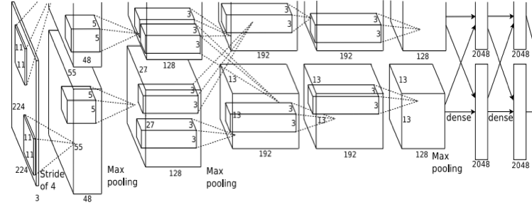
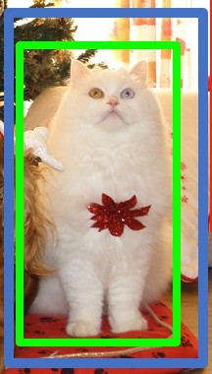
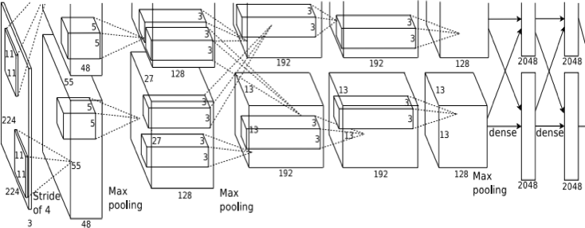
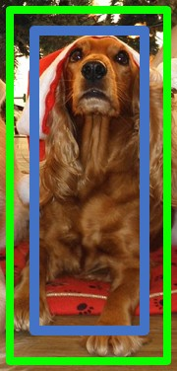
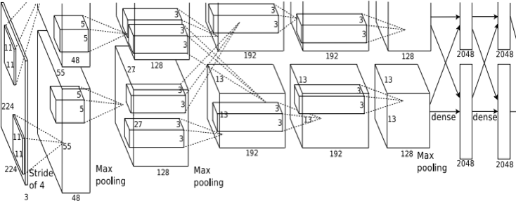
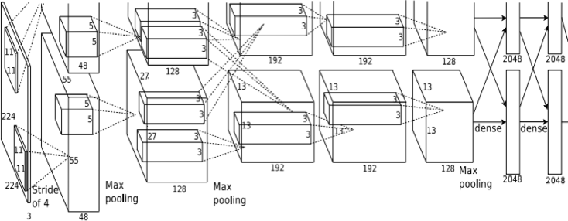
”Slow” R-CNN Training
Run each region through CNN. For positive boxes predict class and box offset; for negative boxes just predict background class
Class target: Dog Box target:
Input Image
Class target: Cat Box target:
Class target: Dog Box target:
Class target: Background Box target: None
GT Boxes
Positive
Neutral
Justin Johnson
Negative
This image is CC0 public domain
Lecture 16 - 12

Slide 13
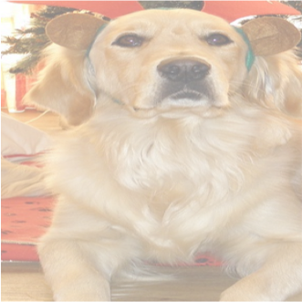
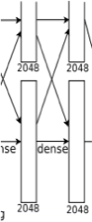

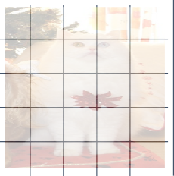
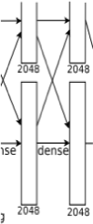
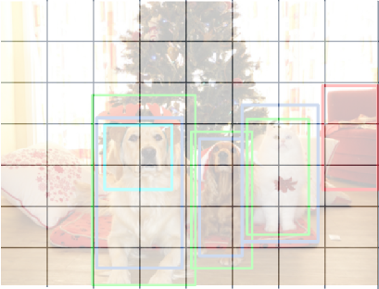
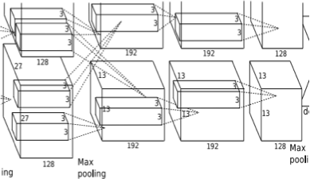
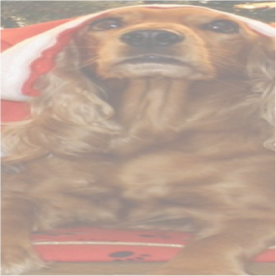

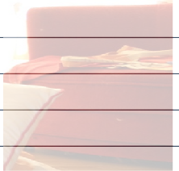

Fast R-CNN Training
Crop features for each region, use them to predict class and box targets per region
Class target: Dog Box target:
Input Image
Image Features
Backbone
Class target: Cat Box target:
CNN
Class target: Dog Box target:
Class target: Background Box target: None
GT Boxes
Positive
Neutral
Negative
This image is CC0 public domain
Lecture 16 - 13

Slide 14
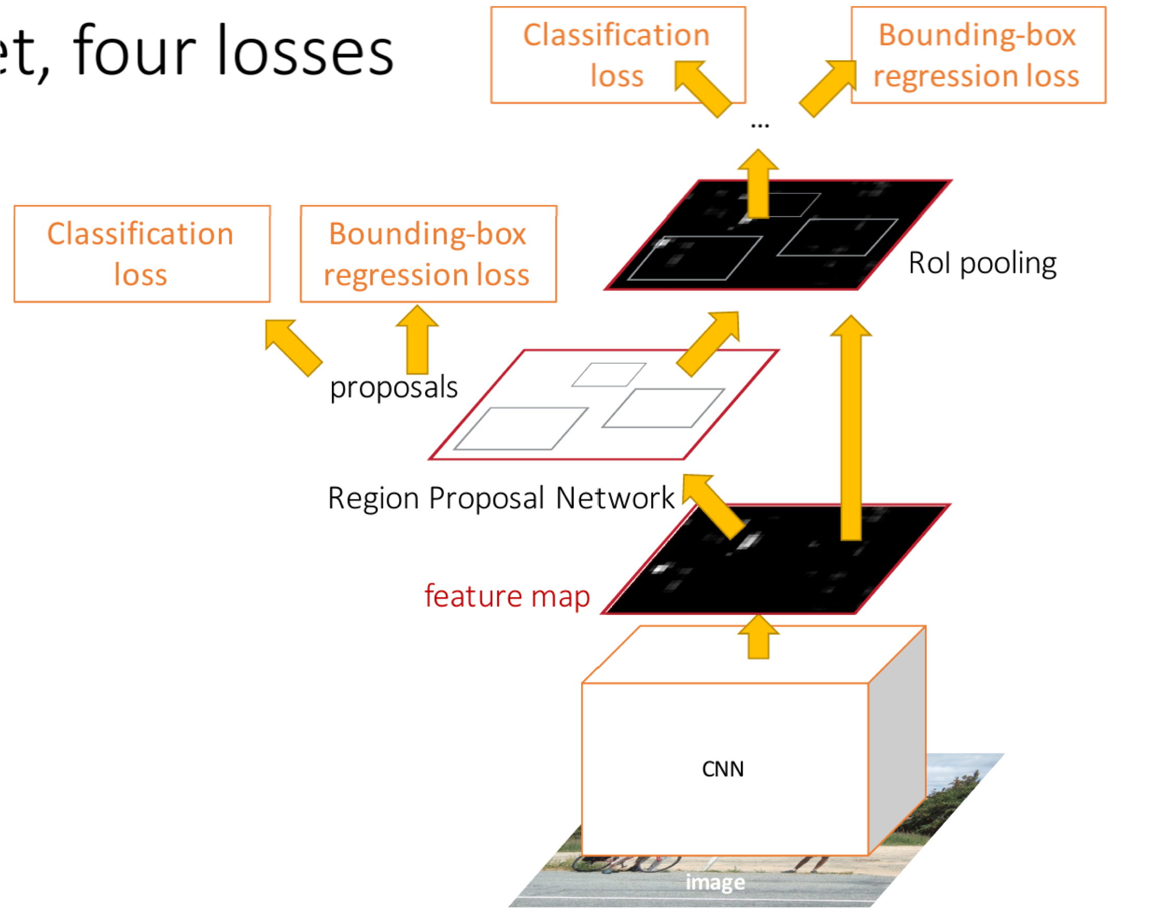
Faster R-CNN: Learnable Region Proposals
Jointly train with 4 losses:
RPN classification: anchor box is object / not an object
RPN regression: predict transform from anchor box to proposal box
Object classification: classify
proposals as background / object class
Object regression: predict transform from proposal box to object box
Anchor -> Region Proposal -> Object Box (Stage 1) (Stage 2)
Training each stage looks a lot like Fast R-CNN:

Slide 15
Faster R-CNN Training: RPN Training
RPN predicts Object / Background for each anchor, as well as regresses from anchor to object box
Class target: Obj Box target:
Class target: Obj Box target:
Class target: Obj Box target:
Class target: Background Box target: None
Input Image
Image Features
Backbone
CNN
RPN gives lots of anchors which we classify as pos / neg / neutral by matching with ground-truth
GT Boxes
Positive
Neutral
Negative
This image is CC0 public domain

Slide 16
Faster R-CNN Training: Stage 2
Crop features for each proposal, use them to predict class and box targets per region
Class target: Dog Box target:
Class target: Cat Box target:
Class target: Dog Box target:
Class target: Background Box target: None
Input Image
Image Features
Backbone
CNN
Now proposals come from RPN rather than selective search, but otherwise this works the same as Fast R-CNN training
GT Boxes
Positive
Neutral
Negative
This image is CC0 public domain

Slide 17
Recap: Fast R-CNN Feature Cropping
“Slow” R-CNN: Run CNN
independently for each region
Fast R-CNN: Apply differentiable cropping to shared image features
Bbox Class
Bbox Class
Class
Bbox
Bbox
Bbox
Category and box transform per region
Bbox
Forward each region through ConvNet
Warped image regions (224x224)
Class
Class
Class
Conv Net
Conv Net
Regions of Interest (RoIs) from a proposal method
Per-Region Network
Crop + Resize features Image features
Run whole image through ConvNet
CNN
CNN
CNN
Conv Net
“Backbone” network: AlexNet, VGG, ResNet, etc
Regions of Interest (RoI) from a proposal method (~2k)
Input image
ConvNet
Input image

Slide 18
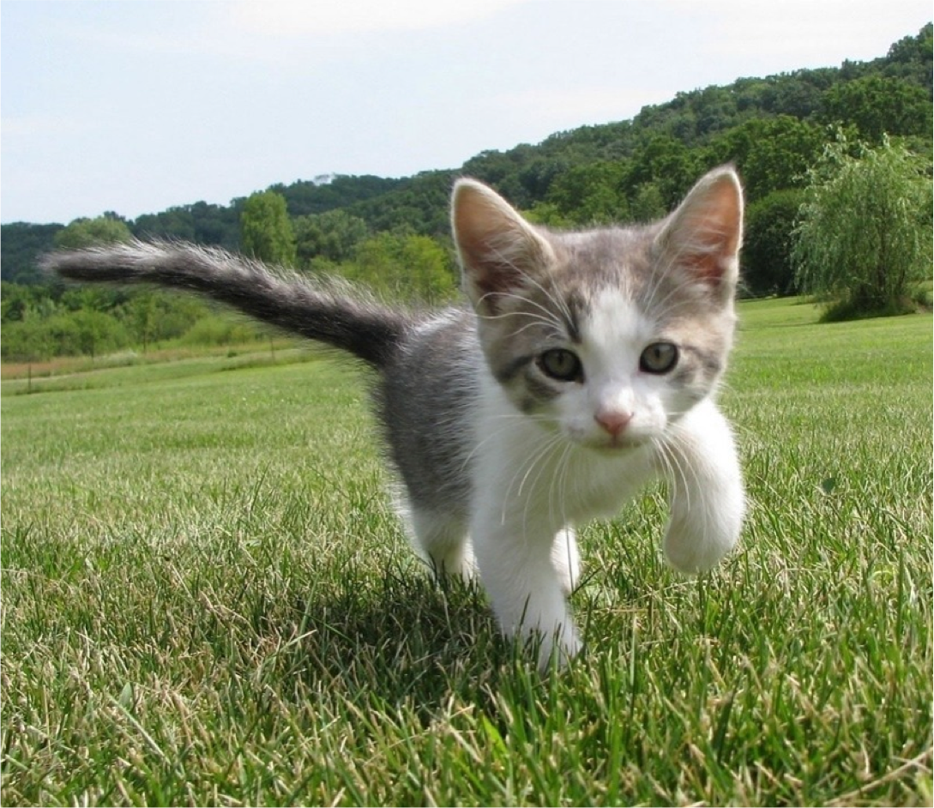
Cropping Features
Goal: Crop features for region proposal, and resize to a fixed size for downstream processing, in a differentiable way
Project proposal onto features
CNN
Region features (here 512 x 2 x 2;
In practice e.g 512 x 7 x 7)
Input Image (e.g. 3 x 640 x 480)
Image features (e.g. 512 x 20 x 15)
Girshick, “Fast R-CNN”, ICCV 2015.

Slide 19
Cropping Features: RoI Pool
Divide into 2x2 grid of (roughly) equal subregions
Max-pool within each subregion
“Snap” to grid cells
Project proposal
onto features
CNN
Region features (here 512 x 2 x 2;
In practice e.g 512 x 7 x 7)
Input Image (e.g. 3 x 640 x 480)
Image features (e.g. 512 x 20 x 15)
Region features always the same size even if input regions have different sizes!
Girshick, “Fast R-CNN”, ICCV 2015.

Slide 20




Cropping Features: RoI Pool
Divide into 2x2
“Snap” to grid cells ^{grid of (roughly)}
equal subregions
Project proposal onto features
Max-pool within each subregion
CNN
Region features
(here 512 x 2 x 2;
In practice e.g 512 x 7 x 7)
Problem #1: Misaligned features due to snapping
Input Image (e.g. 3 x 640 x 480)
Image features (e.g. 512 x 20 x 15)

Slide 21
Cropping Features: RoI Pool
Divide into 2x2
“Snap” to grid cells ^{grid of (roughly)}
equal subregions
Project proposal onto features
Max-pool within each subregion
CNN
Region features
(here 512 x 2 x 2;
In practice e.g 512 x 7 x 7)
Problem #1: Misaligned features due to snapping Problem #2: Can’t backprop to box coordinates
Input Image (e.g. 3 x 640 x 480)
Image features (e.g. 512 x 20 x 15)
Region Features = f(image features, box coordinates)

Slide 22


Cropping Features: RoI Align
Divide into equal-sized subregions (may not be aligned to grid!)
No “snapping”!
Sample features at regularly-spaced points in each subregion using bilinear interpolation
Project proposal onto features
CNN
Input Image (e.g. 3 x 640 x 480)
Image features (e.g. 512 x 20 x 15)
He et al, “Mask R-CNN”, ICCV 2017

Slide 23


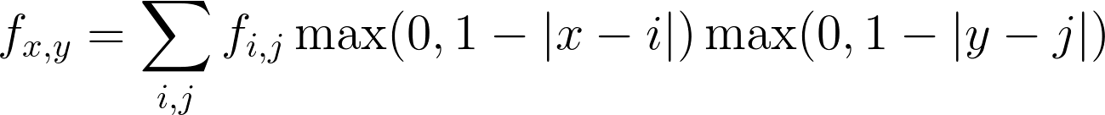
Cropping Features: RoI Align
Divide into equal-sized subregions (may not be aligned to grid!)
No “snapping”!
Sample features at regularly-spaced points in each subregion using bilinear interpolation
^{f}6,5 ^{f}7,5
Project proposal onto features
CNN
^{f}6.5,5.8
^{f}7,6
^{f}6,6
Feature f_{xy} for point (x, y) is a linear combination of features
at its four neighboring grid cells:
November 11, 2019

Slide 24
Cropping Features: RoI Align
No “snapping”!
Sample features at regularly-spaced points in each subregion using bilinear interpolation
^{f}6,5 ^{f}7,5
Project proposal onto features
CNN
^{f}6.5,5.8
^{f}7,6
^{f}6,6
f_{6.5,5.8} = (f_{6,5} * 0.5 * 0.2) + (f_{7,5} * 0.5 * 0.2)
+ (f_{6,6} * 0.5 * 0.8) + (f_{7,6} * 0.5 * 0.8)
Feature f_{xy} for point (x, y) is a linear combination of features
at its four neighboring grid cells:
November 11, 2019

Slide 25
Cropping Features: RoI Align
Divide into equal-sized subregions (may not be aligned to grid!)
No “snapping”!
Sample features at regularly-spaced points in each subregion using bilinear interpolation
Project proposal onto features
^{f}6,5
0.8
0.5
^{f}7,5
CNN
^{f}6.5,5.8
^{f}7,6
^{f}6,6
f_{6.5,5.8} = (f_{6,5} * 0.5 * 0.2) + (f_{7,5} * 0.5 * 0.2)
+ (f_{6,6} * 0.5 * 0.8) + (f_{7,6} * 0.5 * 0.8)
Feature f_{xy} for point (x, y) is a linear combination of features
at its four neighboring grid cells:
November 11, 2019

Slide 26
Cropping Features: RoI Align
No “snapping”!
Sample features at regularly-spaced points in each subregion using bilinear interpolation
^{f}6,5 ^{f}7,5
Project proposal onto features
CNN
0.8
^{f}6.5,5.8
0.5
^{f}7,6
f
6,6
f_{6.5,5.8} = (f_{6,5} * 0.5 * 0.2) + (f_{7,5} * 0.5 * 0.2)
+ (f_{6,6} * 0.5 * 0.8) + (f_{7,6} * 0.5 * 0.8)
Feature f_{xy} for point (x, y) is a linear combination of features
at its four neighboring grid cells:
November 11, 2019

Slide 27
Cropping Features: RoI Align
Divide into equal-sized subregions (may not be aligned to grid!)
No “snapping”!
Sample features at regularly-spaced points in each subregion using bilinear interpolation
^{f}6,5 ^{f}7,5
Project proposal onto features
CNN
_{0.2} 0.5
^{f}6,6
^{f}6.5,5.8
^{f}7,6
f_{6.5,5.8} = (f_{6,5} * 0.5 * 0.2) + (f_{7,5} * 0.5 * 0.2)
+ (f_{6,6} * 0.5 * 0.8) + (f_{7,6} * 0.5 * 0.8)
Feature f_{xy} for point (x, y) is a linear combination of features
at its four neighboring grid cells:
November 11, 2019

Slide 28
Cropping Features: RoI Align
No “snapping”!
Sample features at regularly-spaced points in each subregion using bilinear interpolation
^{f}6,5 ^{f}7,5
Project proposal onto features
CNN
^{f}6.5,5.8
0.5 f_{7,6}
0.2
^{f}6,6
f_{6.5,5.8} = (f_{6,5} * 0.5 * 0.2) + (f_{7,5} * 0.5 * 0.2)
+ (f_{6,6} * 0.5 * 0.8) + (f_{7,6} * 0.5 * 0.8)
Feature f_{xy} for point (x, y) is a linear combination of features
at its four neighboring grid cells:
November 11, 2019

Slide 29
Cropping Features: RoI Align
Divide into equal-sized subregions (may not be aligned to grid!)
No “snapping”!
Sample features at regularly-spaced points in each subregion using bilinear interpolation
^{f}6,5 ^{f}7,5
Project proposal onto features
CNN
^{f}6.5,5.8
^{f}7,6
^{f}6,6
Feature f_{xy} for point (x, y) is a linear combination of features at its four neighboring grid cells:
This is differentiable! Upstream gradient for sampled feature will flow backward into each of the four nearest-neighbor gridpoints
Lecture 16 - 29

Slide 30
Cropping Features: RoI Align
Divide into equal-sized subregions (may not be aligned to grid!)
No “snapping”!
Sample features at regularly-spaced points in each subregion using bilinear interpolation
After sampling, max- pool in each subregion
Project proposal onto features
CNN
Region features (here 512 x 2 x 2;
In practice e.g 512 x 7 x 7)
Input Image (e.g. 3 x 640 x 480)
Image features (e.g. 512 x 20 x 15)
Output features now aligned to input box! And we can backprop to box coordinates!

Slide 31
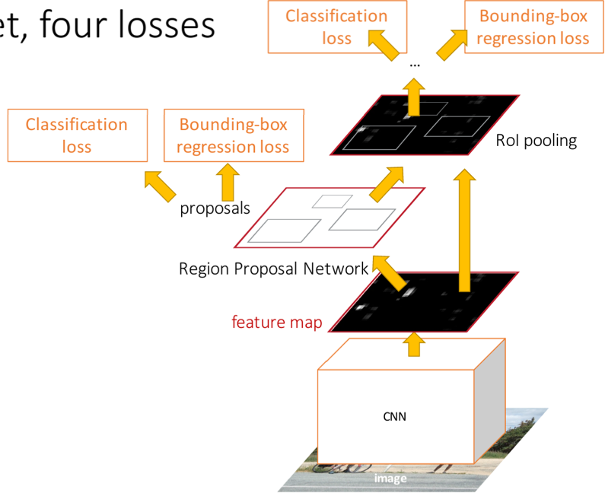
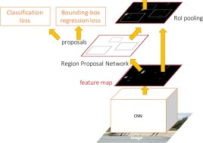


Object Detection Methods
Both of these rely on anchor boxes. Can we do detection without anchors?
“Slow” R-CNN: Run CNN independently for each region
Fast R-CNN: Apply differentiable cropping to shared image features
Faster R-CNN: Compute proposals with CNN
Single-Stage:
Fully convolutional detector
Bbox |  | Class
Bbox
Class
Bbox
Class
Conv Net
Forward each region through ConvNet
Warped image regions (224x224)
Conv Net
Bbox |  | Bbox |  | Bbox
Class |  | Class |  | Class
Category and box transform per region
Conv Net
Regions of Interest (RoIs) from a proposal method
Per-Region Network
Crop + Resize features Image features
Run whole image through ConvNet
CNN
CNN
CNN
Input image
Regions of Interest (RoI) from a proposal method (~2k)
“Backbone” network: AlexNet, VGG, ResNet, etc
ConvNet
Input image

Slide 32
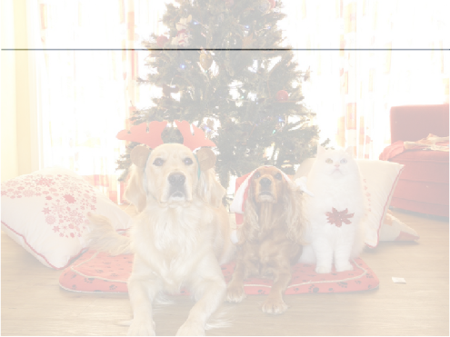



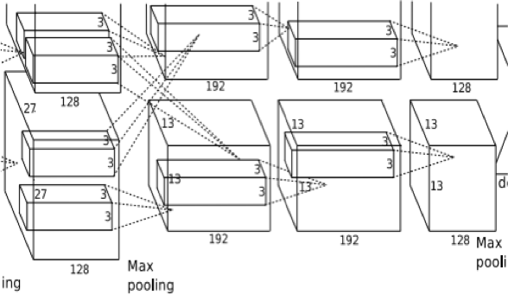




Detection without Anchors: CornerNet
Upper left corners Heatmap: C x H x W Embeddings: D x H x W
Backbone CNN
Matching corners are trained to have similar embeddings
Lower right corners Heatmap: C x H x W Embeddings: D x H x W
Represent bounding boxes by pairs of corners
Law and Deng, “CornerNet: Detecting Objects as Paired Keypoints”, ECCV 2018

Slide 33
Computer Vision Tasks: Object Detection
Semantic Segmentation
Object Detection
Instance Segmentation
Classification
CAT
GRASS, CAT, TREE, SKY
DOG, DOG, CAT
DOG, DOG, CAT
No spatial extent
No objects, just pixels
Multiple Objects

Slide 34
Computer Vision Tasks: Semantic Segmentation
Semantic Segmentation
Object Detection
Instance Segmentation
Classification
CAT
GRASS, CAT, TREE, SKY
DOG, DOG, CAT
DOG, DOG, CAT
No spatial extent
No objects, just pixels
Multiple Objects

Slide 35

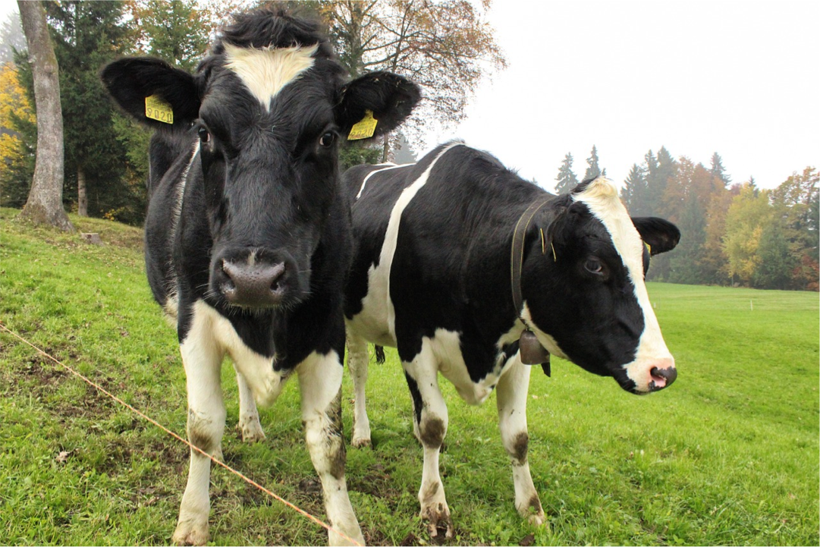
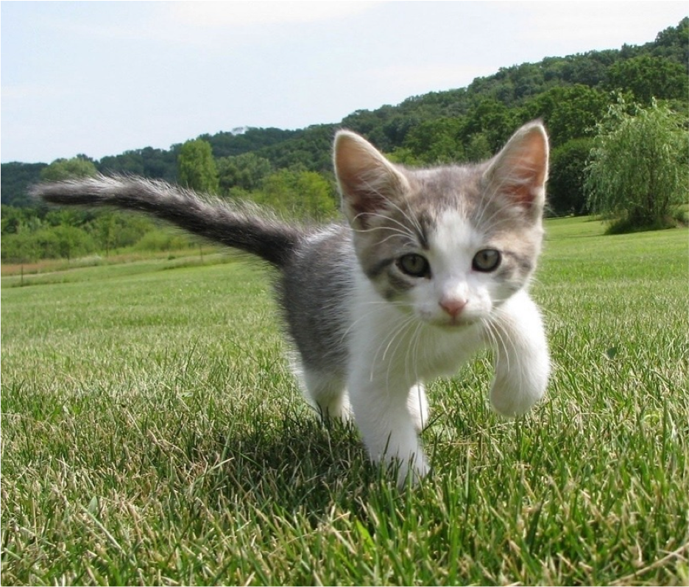
Semantic Segmentation
This image is CC0 public domain
Label each pixel in the image with a category label
Sky
Sky
Cow
Grass
Don’t differentiate instances, only care about pixels
Trees
Trees
Cat
Grass

Slide 36
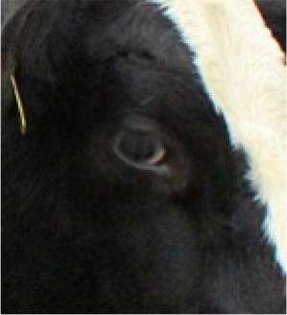
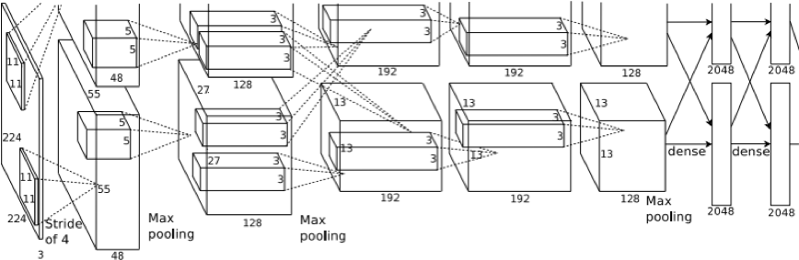
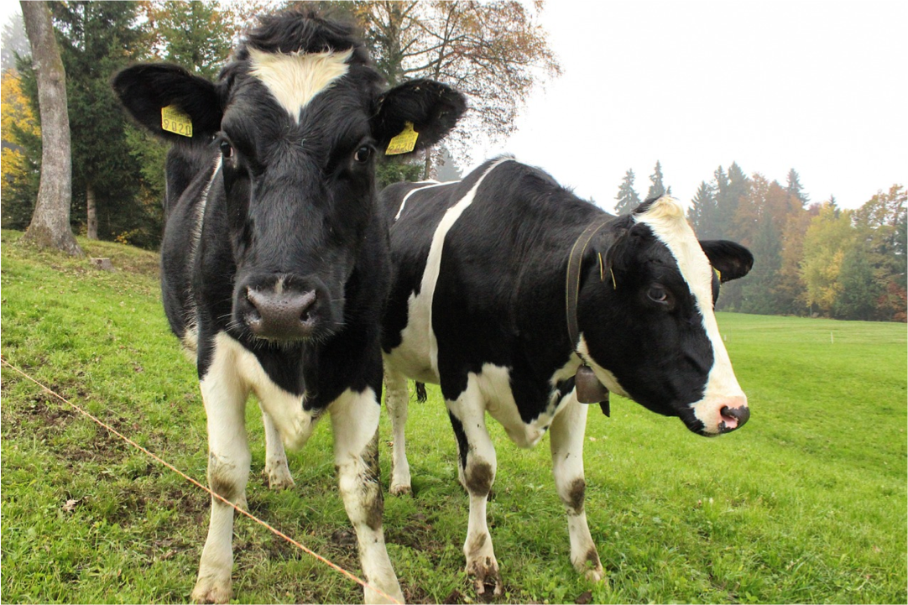

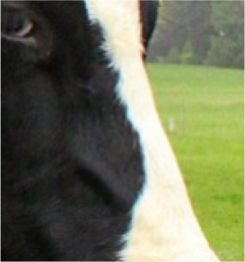


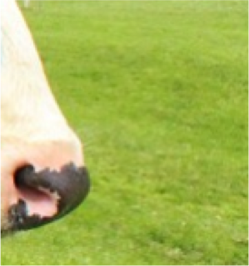
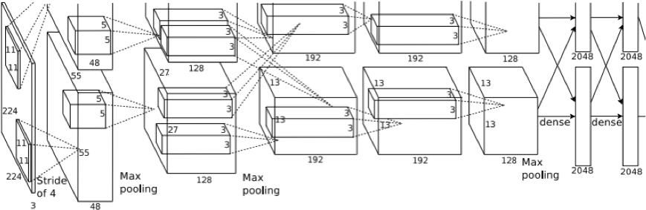

Semantic Segmentation Idea: Sliding Window
Extract patch
Classify center pixel with CNN
Full image
Cow
Cow
Grass
Farabet et al, “Learning Hierarchical Features for Scene Labeling,” TPAMI 2013
Pinheiro and Collobert, “Recurrent Convolutional Neural Networks for Scene Labeling”, ICML 2014

Slide 37
Semantic Segmentation Idea: Sliding Window
Extract patch
Classify center pixel with CNN
Full image
Cow
Cow
Grass
Problem: Very inefficient! Not reusing shared features between overlapping patches
Farabet et al, “Learning Hierarchical Features for Scene Labeling,” TPAMI 2013
Pinheiro and Collobert, “Recurrent Convolutional Neural Networks for Scene Labeling”, ICML 2014

Slide 38
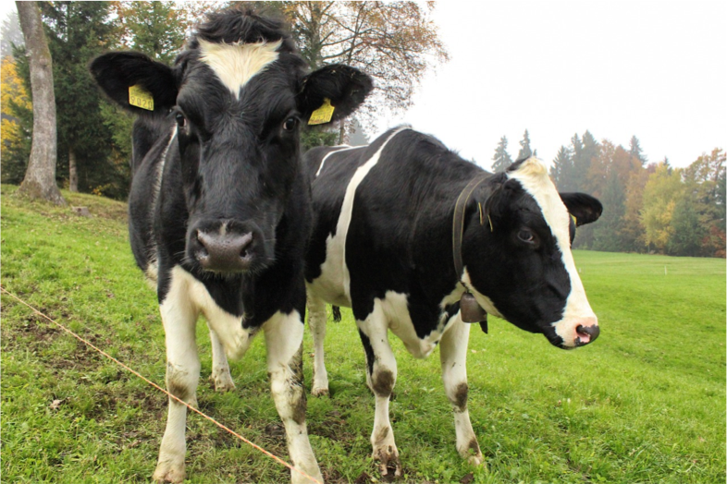
Semantic Segmentation: Fully Convolutional Network
Design a network as a bunch of convolutional layers to make predictions for pixels all at once!
Conv
Conv
Conv
Conv
argmax
Input: 3 x H x W
Scores: C x H x W
Predictions: H x W
Convolutions: D x H x W
Loss function: Per-Pixel cross-entropy
Long et al, “Fully convolutional networks for semantic segmentation”, CVPR 2015

Slide 39
Semantic Segmentation: Fully Convolutional Network
Design a network as a bunch of convolutional layers to make predictions for pixels all at once!
Conv
Conv
Conv
Conv
argmax
Input: 3 x H x W
Problem #1: Effective receptive field size is linear in number of conv layers: With L 3x3 conv layers, receptive field is 1+2L
Long et al, “Fully convolutional networks for semantic segmentation”, CVPR 2015

Slide 40
Semantic Segmentation: Fully Convolutional Network
Design a network as a bunch of convolutional layers to make predictions for pixels all at once!
Conv
Conv
Conv
Conv
argmax
Input: 3 x H x W
Problem #1: Effective receptive field size is linear in number of conv layers: With L 3x3 conv
Problem #2: Convolution on high res images is expensive! Recall ResNet stem aggressively
layers, receptive field is 1+2L
Long et al, “Fully convolutional networks for semantic segmentation”, CVPR 2015
downsamples

Slide 41
Semantic Segmentation: Fully Convolutional Network
Design network as a bunch of convolutional layers, with
downsampling and upsampling inside the network!
Med-res: D₂ x H/4 x W/4
Med-res: D₂ x H/4 x W/4
Low-res:
D₃ x H/4 x W/4
Input: 3 x H x W
High-res: D₁ x H/2 x W/2
High-res: D₁ x H/2 x W/2
Predictions: H x W
Long, Shelhamer, and Darrell, “Fully Convolutional Networks for Semantic Segmentation”, CVPR 2015
Noh et al, “Learning Deconvolution Network for Semantic Segmentation”, ICCV 2015

Slide 42
Semantic Segmentation: Fully Convolutional Network
Downsampling: Pooling, strided convolution
Design network as a bunch of convolutional layers, with
Upsampling:
???
downsampling and upsampling inside the network!
Med-res: D₂ x H/4 x W/4
Med-res: D₂ x H/4 x W/4
Low-res:
D₃ x H/4 x W/4
Input: 3 x H x W
High-res: D₁ x H/2 x W/2
High-res: D₁ x H/2 x W/2
Predictions: H x W
Long, Shelhamer, and Darrell, “Fully Convolutional Networks for Semantic Segmentation”, CVPR 2015
Noh et al, “Learning Deconvolution Network for Semantic Segmentation”, ICCV 2015

Slide 43
In-Network Upsampling: “Unpooling”
Bed of Nails
1 | 0 | 2 | 0
0 | 0 | 0 | 0
3 | 0 | 4 | 0
0 | 0 | 0 | 0
1 | 2
3 | 4
Input C x 2 x 2
Output C x 4 x 4

Slide 44
In-Network Upsampling: “Unpooling”
Bed of Nails Nearest Neighbor
1 | 0 | 2 | 0
0 | 0 | 0 | 0
3 | 0 | 4 | 0
0 | 0 | 0 | 0
1 | 1 | 2 | 2
1 | 1 | 2 | 2
3 | 3 | 4 | 4
3 | 3 | 4 | 4
1 | 2
3 | 4
1 | 2
3 | 4
Input C x 2 x 2
Output C x 4 x 4
Input C x 2 x 2
Output C x 4 x 4

Slide 45


In-Network Upsampling: Bilinear Interpolation
1.00 | 1.25 | 1.75 | 2.00
1.50 | 1.75 | 2.25 | 2.50
2.50 | 2.75 | 3.25 | 3.50
3.00 | 3.25 | 3.75 | 4.00
1 | 2
3 | 4
Input: C x 2 x 2
Output: C x 4 x 4
Use two closest neighbors in x and y to construct linear approximations

Slide 46
In-Network Upsampling: Bicubic Interpolation
0.68 | 1.02 | 1.56 | 1.89
1.35 | 1.68 | 2.23 | 2.56
2.44 | 2.77 | 3.32 | 3.65
3.11 | 3.44 | 3.98 | 4.32
1 | 2
3 | 4
Input: C x 2 x 2 Output: C x 4 x 4
Use three closest neighbors in x and y to construct cubic approximations
(This is how we normally resize images!)

Slide 47
In-Network Upsampling: “Max Unpooling”
Max Pooling: Remember which position had the max
Max Unpooling: Place into remembered positions
1 | 2 | 6 | 3
3 | 5 | 2 | 1
1 | 2 | 2 | 1
7 | 3 | 4 | 8
0 | 0 | 2 | 0
0 | 1 | 0 | 0
0 | 0 | 0 | 0
3 | 0 | 0 | 4
5 | 6
7 | 8
Rest of net
Pair each downsampling layer with an upsampling layer
1 | 2
3 | 4
Noh et al, “Learning Deconvolution Network for Semantic Segmentation”, ICCV 2015

Slide 48
Learnable Upsampling: Transposed Convolution
Recall: Normal 3 x 3 convolution, stride 1, pad 1
Input: 4 x 4
Output: 4 x 4

Slide 49
Learnable Upsampling: Transposed Convolution
Recall: Normal 3 x 3 convolution, stride 1, pad 1
Dot product between input and filter
Input: 4 x 4
Output: 4 x 4

Slide 50
Learnable Upsampling: Transposed Convolution
Recall: Normal 3 x 3 convolution, stride 1, pad 1
Dot product between input and filter
Input: 4 x 4
Output: 4 x 4

Slide 51
Learnable Upsampling: Transposed Convolution
Recall: Normal 3 x 3 convolution, stride 2, pad 1
Input: 4 x 4
Output: 2 x 2

Slide 52
Learnable Upsampling: Transposed Convolution
Recall: Normal 3 x 3 convolution, stride 2, pad 1
Dot product between input and filter
Input: 4 x 4
Output: 2 x 2

Slide 53
Learnable Upsampling: Transposed Convolution
Recall: Normal 3 x 3 convolution, stride 2, pad 1
Dot product between input and filter
Input: 4 x 4
Output: 2 x 2

Slide 54
Learnable Upsampling: Transposed Convolution
Recall: Normal 3 x 3 convolution, stride 2, pad 1
Convolution with stride > 1 is “Learnable Downsampling” Can we use stride < 1 for “Learnable Upsampling”?
Dot product between input and filter
Input: 4 x 4
Output: 2 x 2

Slide 55
Learnable Upsampling: Transposed Convolution
3 x 3 convolution transpose, stride 2
Input: 2 x 2
Output: 4 x 4

Slide 56
Learnable Upsampling: Transposed Convolution
3 x 3 convolution transpose, stride 2
Weight filter by input value and copy to output
Input: 2 x 2
Output: 4 x 4

Slide 57
Learnable Upsampling: Transposed Convolution
3 x 3 convolution transpose, stride 2
Filter moves 2 pixels in output for every 1 pixel in input
Weight filter by input value and copy to output
Input: 2 x 2
Output: 4 x 4

Slide 58
Learnable Upsampling: Transposed Convolution
Sum where
3 x 3 convolution transpose, stride 2
output overlaps
Filter moves 2 pixels in output for every 1 pixel in input
Weight filter by input value and copy to output
Input: 2 x 2
Output: 4 x 4

Slide 59
Learnable Upsampling: Transposed Convolution
Sum where
3 x 3 convolution transpose, stride 2
output overlaps
This gives 5x5 output – need to trim one pixel from top and left to give 4x4 output
Weight filter by input value and copy to output
Input: 2 x 2
Output: 4 x 4

Slide 60
Transposed Convolution: 1D example
Input Filter Output
Output has copies of filter weighted by input
ax
ay
az
 | + | bx
 |  | by
 |  | bz
x
y
z
a
Stride 2: Move 2 pixels output for each pixel in input
b
Sum at overlaps

Slide 61
Transposed Convolution: 1D example
Input Filter Output
This has many names:
ax
ay
az
 | + | bx
 |  | by
 |  | bz
Deconvolution (bad)!
Upconvolution
Fractionally strided convolution
Backward strided convolution
Transposed Convolution (best name)
x
y
z
a
b

Slide 62
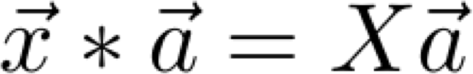
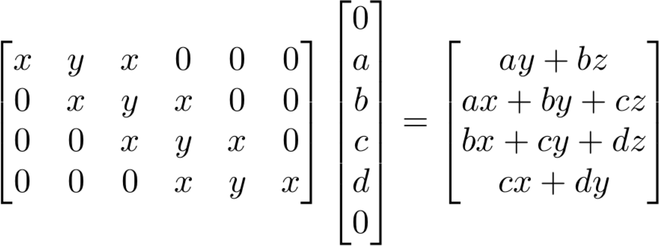
Convolution as Matrix Multiplication (1D Example)
We can express convolution in terms of a matrix multiplication
Example: 1D conv, kernel size=3, stride=1, padding=1

Slide 63
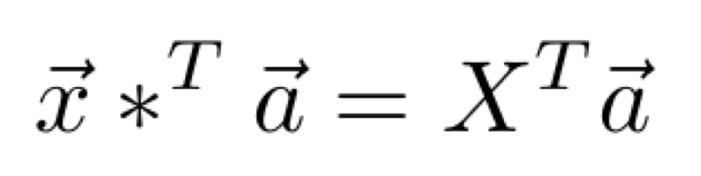
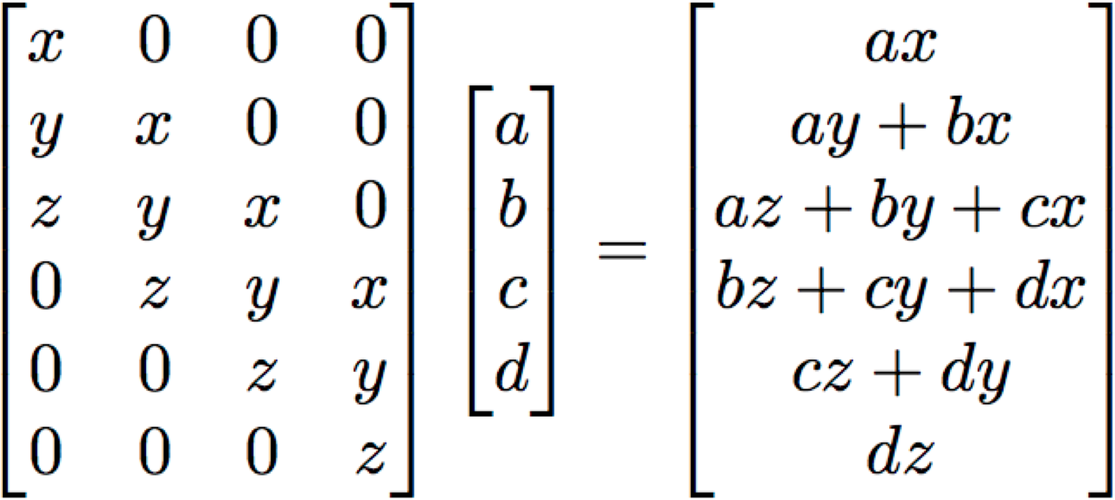
Convolution as Matrix Multiplication (1D Example)
We can express convolution in terms of a matrix multiplication
Transposed convolution multiplies by the transpose of the same matrix:
Example: 1D conv, kernel size=3, stride=1, padding=1
When stride=1, transposed conv is just a regular conv (with different padding rules)

Slide 64
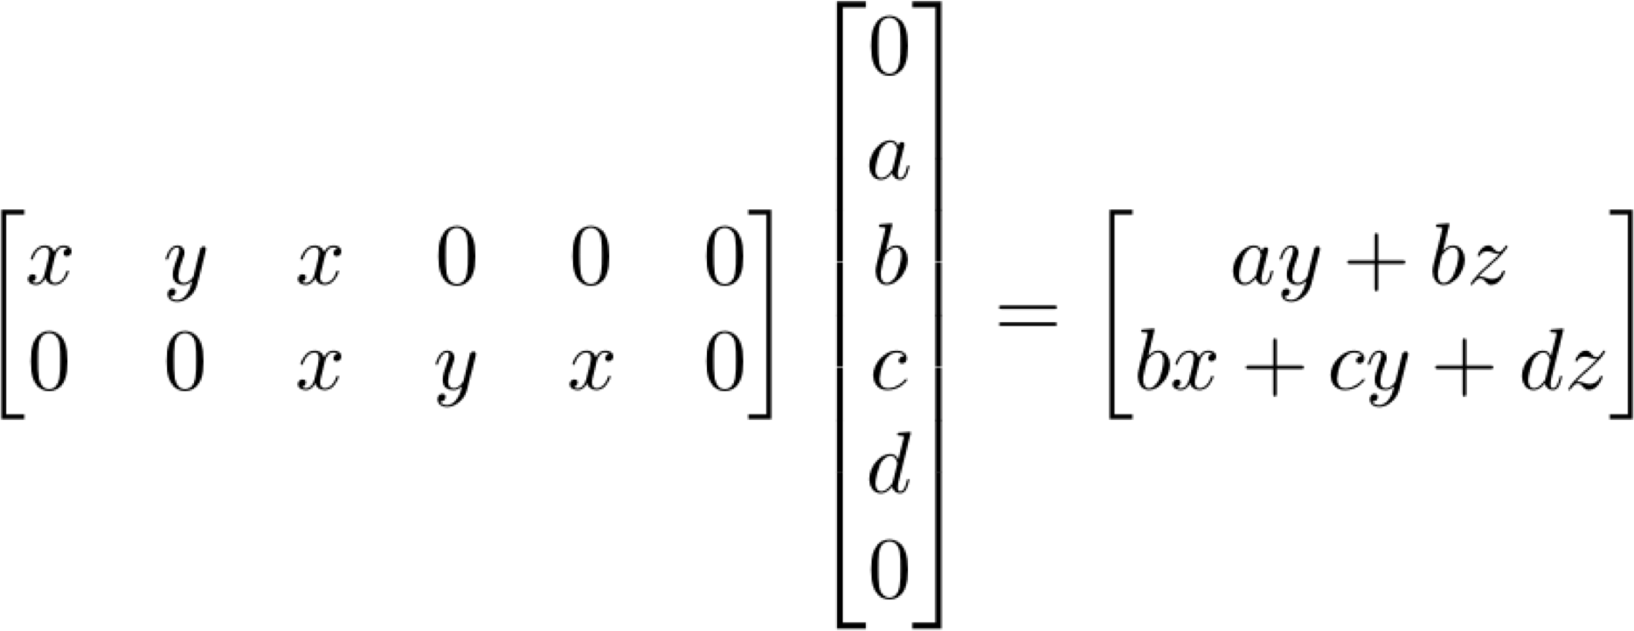
Convolution as Matrix Multiplication (1D Example)
We can express convolution in terms of a matrix multiplication
Transposed convolution multiplies by the transpose of the same matrix:
Example: 1D conv, kernel size=3, stride=2, padding=1

Slide 65
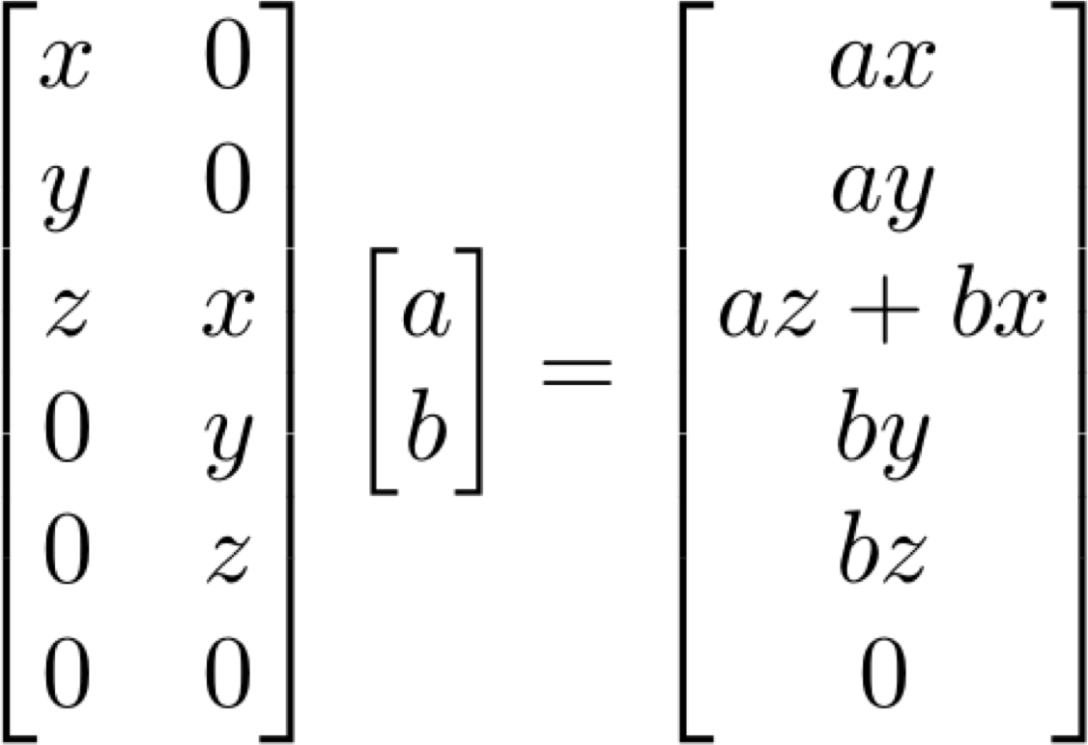
Convolution as Matrix Multiplication (1D Example)
We can express convolution in terms of a matrix multiplication
Transposed convolution multiplies by the transpose of the same matrix:
Example: 1D conv, kernel size=3, stride=2, padding=1
When stride>1, transposed convolution cannot be expressed as normal conv

Slide 66
Semantic Segmentation: Fully Convolutional Network
Design network as a bunch of convolutional layers, with
downsampling and upsampling inside the network!
Upsampling: Iinterpolation, transposed conv
Downsampling: Pooling, strided convolution
Med-res: D₂ x H/4 x W/4
Med-res: D₂ x H/4 x W/4
Low-res:
D₃ x H/4 x W/4
Input: 3 x H x W
High-res: D₁ x H/2 x W/2
High-res: D₁ x H/2 x W/2
Predictions: H x W
Loss function: Per-Pixel cross-entropy
Long, Shelhamer, and Darrell, “Fully Convolutional Networks for Semantic Segmentation”, CVPR 2015 Noh et al, “Learning Deconvolution Network for Semantic Segmentation”, ICCV 2015

Slide 67

Computer Vision Tasks
Object Detection: Detects individual object instances, but only gives box
Semantic Segmentation: Gives per- pixel labels, but merges instances
Sky
Cow
Grass
Trees

Slide 68
Things and Stuff
This image is CC0 public domain
Things: Object categories that can be separated into object instances
(e.g. cats, cars, person)
Sky
Sky
Cow
Grass
Stuff: Object categories that cannot be separated into instances
(e.g. sky, grass, water, trees)
Trees
Trees
Cat
Grass

Slide 69
Computer Vision Tasks
Object Detection: Detects individual object instances, but only gives box (Only things!)
Semantic Segmentation: Gives per- pixel labels, but merges instances (Both things and stuff)
Sky
Cow
Grass
Trees

Slide 70
Computer Vision Tasks: Instance Segmentation
Semantic Segmentation
Object Detection
Instance Segmentation
Classification
CAT
GRASS, CAT, TREE, SKY
DOG, DOG, CAT
DOG, DOG, CAT
No spatial extent
No objects, just pixels
Multiple Objects

Slide 71
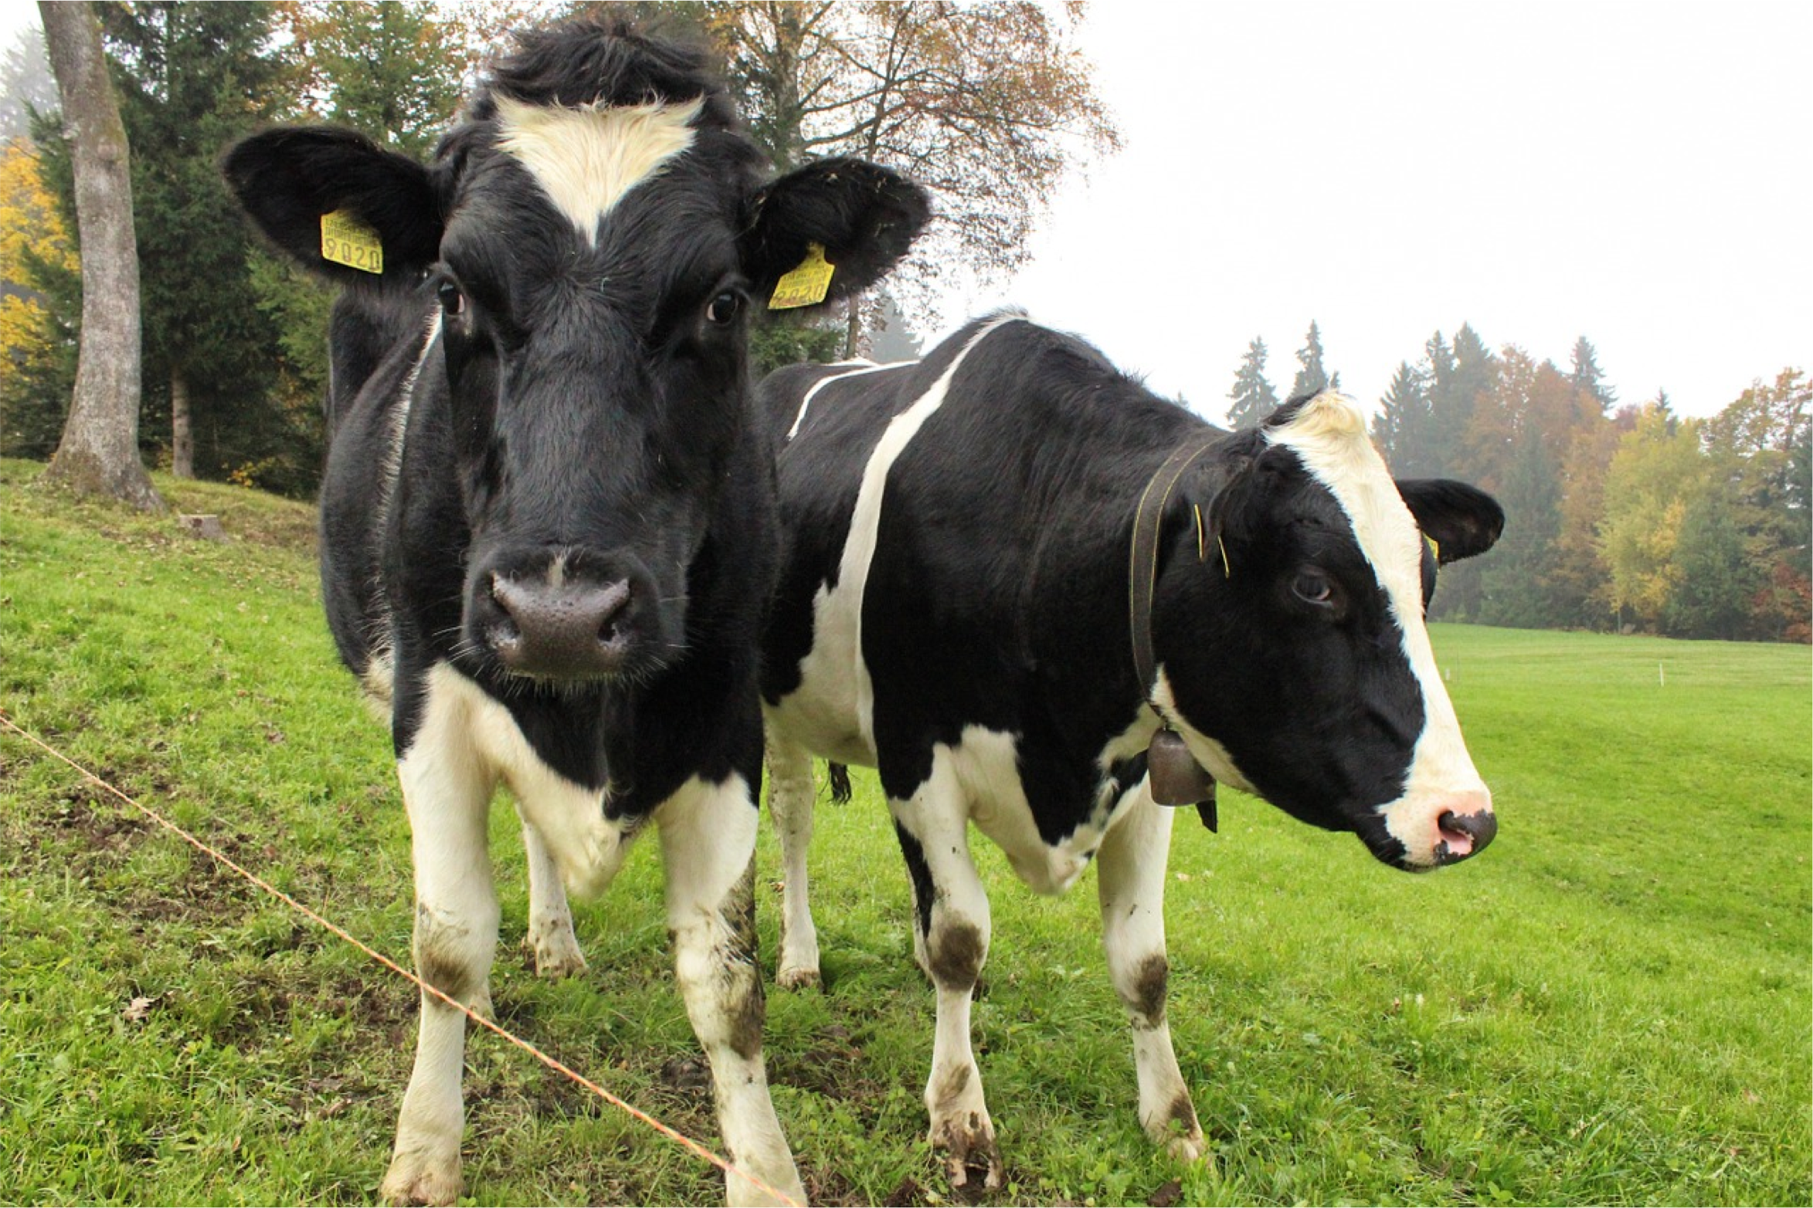
Computer Vision Tasks: Instance Segmentation
Instance Segmentation:
Cow
Detect all objects in the image, and identify the pixels that belong to each object (Only things!)
Cow
This image is CC0 public domain

Slide 72
Computer Vision Tasks: Instance Segmentation
Instance Segmentation:
Cow
Detect all objects in the image, and identify the pixels that belong to each object (Only things!)
Cow
Approach: Perform object detection, then predict a segmentation mask for each object!
This image is CC0 public domain

Slide 73
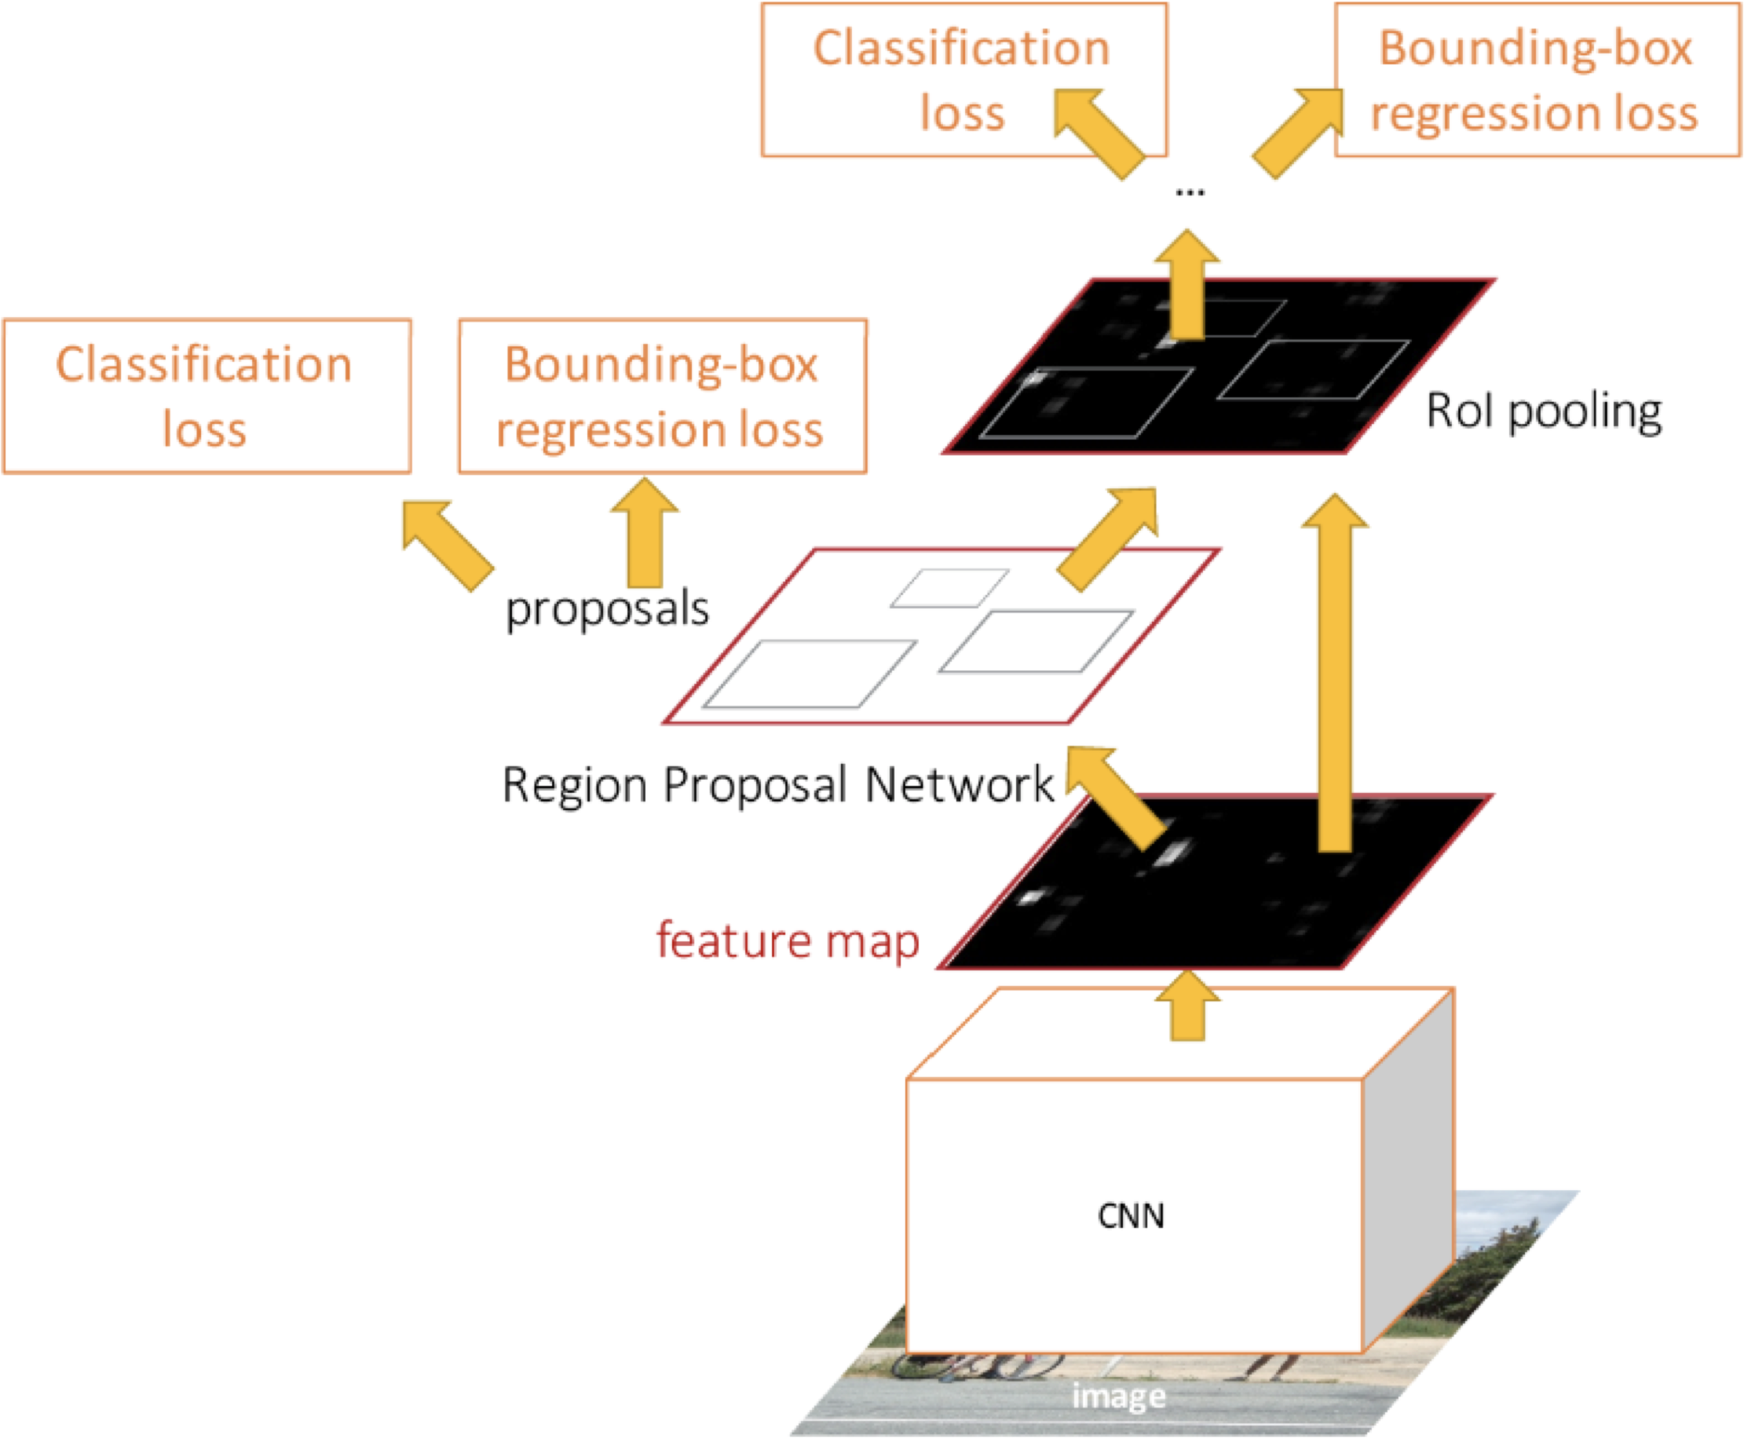

Object Detection: Faster R-CNN
Ren et al, “Faster R-CNN: Towards Real-Time Object Detection with Region Proposal Networks”, NeurIPS 2015

Slide 74
Instance Segmentation:
Mask R-CNN
Mask Prediction
He et al, “Mask R-CNN”, ICCV 2017

Slide 75

Mask R-CNN
Classification Scores: C
Box coordinates (per class): 4 * C
CNN
+RPN
Conv Conv
256 x 14 x 14
RoI Align
256 x 14 x 14
Predict a mask for each of C classes: C x 28 x 28
He et al, “Mask R-CNN”, ICCV 2017

Slide 76

Mask R-CNN: Example Training Targets

Slide 77
Mask R-CNN: Example Training Targets

Slide 78
Mask R-CNN: Example Training Targets

Slide 79
Mask R-CNN: Example Training Targets

Slide 80



Mask R-CNN: Very Good Results!

Slide 81

Beyond Instance Segmentation
Instance Segmentation: Separate object instances, but only things
Semantic Segmentation: Identify both things and stuff, but doesn’t separate instances
Sky
Cow
Grass
Cow
Trees
Cow

Slide 82

Beyond Instance Segmentation: Panoptic Segmentation
Label all pixels in the image (both things and stuff)
Sky
Trees
Cow #1
Cow #1
Co_{Co}w_{w} #_{#2}2
For “thing” categories also separate into instances
Grass
Kirillov et al, “Panoptic Segmentation”, CVPR 2019
Kirillov et al, “Panoptic Feature Pyramid Networks”, CVPR 2019
Justin Johnson

Slide 83

Beyond Instance Segmentation: Panoptic Segmentation
Kirillov et al, “Panoptic Feature Pyramid Networks”, CVPR 2019
Justin Johnson

Slide 84


Beyond Instance Segmentation: Human Keypoints
Represent the pose of a human by locating a set of keypoints
e.g. 17 keypoints:
Nose
Left / Right eye
Left / Right ear
Left / Right shoulder
Left / Right elbow
Left / Right wrist
Left / Right hip
Left / Right knee
Left / Right ankle
Person image is CC0 public domain

Slide 85

Mask R-CNN:
Instance Segmentation
Mask Prediction
Keypoint estimation
He et al, “Mask R-CNN”, ICCV 2017
Justin Johnson

Slide 86
Mask R-CNN: Keypoint Estimation
Mask Prediction
Keypoint prediction
Keypoint estimation
He et al, “Mask R-CNN”, ICCV 2017
Justin Johnson

Slide 87
Mask R-CNN: Keypoint Estimation
Mask Prediction
Keypoint prediction
Keypoint estimation
He et al, “Mask R-CNN”, ICCV 2017
Justin Johnson

Slide 88
Mask R-CNN: Keypoints
Classification Scores: C
Box coordinates (per class): 4 * C Segmentation mask: C x 28 x 28
One mask for each of the K different keypoints
Left ankle Right ankle
…
CNN
+RPN
Conv…
RoI Align
Keypoint masks: K x 56 x 56
Ground-truth has one “pixel” turned on per keypoint. Train with softmax loss
256 x 14 x 14
He et al, “Mask R-CNN”, ICCV 2017

Slide 89



Joint Instance Segmentation and Pose Estimation
He et al, “Mask R-CNN”, ICCV 2017
Justin Johnson

Slide 90
General Idea: Add Per- Region “Heads” to Faster / Mask R-CNN!
Mask Prediction
Keypoint prediction
Per-Region Heads:
Each receives the features after
RoI Pool / RoI Align, makes some prediction per-region
Keypoint estimation
He et al, “Mask R-CNN”, ICCV 2017
Justin Johnson

Slide 91
Dense Captioning: Predict a caption per region!
Caption prediction (LSTM)
Per-Region Heads:
Each receives the features after
RoI Pool / RoI Align, makes some prediction per-region
Johnson, Karpathy, and Fei-Fei, “DenseCap: Fully Convolutional
Localization Networks for Dense Captioning”, CVPR 2016
Justin Johnson

Slide 92

Dense Captioning
Johnson, Karpathy, and Fei-Fei, “DenseCap: Fully Convolutional Localization Networks for Dense Captioning”, CVPR 2016

Slide 93

Dense Captioning
Johnson, Karpathy, and Fei-Fei, “DenseCap: Fully Convolutional Localization Networks for Dense Captioning”, CVPR 2016

Slide 94
3D Shape Prediction: Predict a 3D triangle mesh per region!
Mesh predictor
Per-Region Heads:
Each receives the features after
RoI Pool / RoI Align, makes some prediction per-region
Gkioxari, Malik, and Johnson, “Mesh R-CNN”, ICCV 2019

Slide 95


3D Shape Prediction: Mask R-CNN + Mesh Head
Mask R-CNN:
2D Image -> 2D shapes
Mesh R-CNN:
2D Image -> 3D shapes
More details next time!
He, Gkioxari, Dollár, and Girshick, “Mask R-CNN”, ICCV 2017
Gkioxari, Malik, and Johnson, “Mesh R-CNN”, ICCV 2019
Lecture 16 - 95

Slide 96
Summary: Many Computer Vision Tasks!
Semantic Segmentation
Object Detection
Instance Segmentation
Classification
CAT
GRASS, CAT, TREE, SKY
DOG, DOG, CAT
DOG, DOG, CAT
No spatial extent
No objects, just pixels
Multiple Objects
This image is CC0 public domain

Slide 97


Next Time: 3D Vision

